Slide 1
Gaming Addiction Prediction
By:
~Kiruthik ks

Slide 2
Problem Statement:
Gaming addiction is an increasing concern, especially among adolescents and young adults. This project aims to predict whether an individual is likely to develop gaming addiction based on few attributes. It includes variables such as player’s gender, age and other details and a target variable reflecting player addiction.

Slide 3
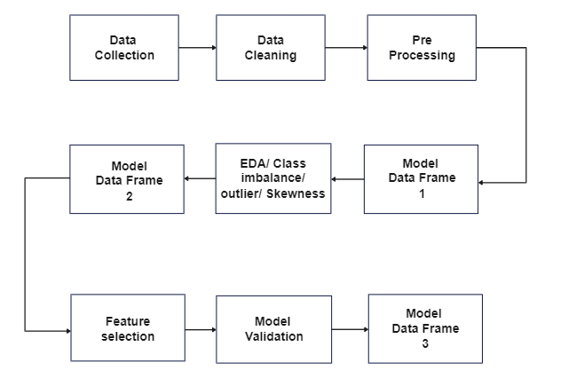
Flow Diagram

Slide 4
Data & Cleaning:
Data consists of 40034 observations and 13 attributes
Target Attribute:
EngagementLevel
Missing Values Treatment:
No missing values detected
Data Type Conversion(Using Label encoder):
Data type of few attributes like Gender, Location, Game Genre, Game Difficulty, Engagement Level have been converted from object to int
Duplicates:
No duplicates were found in the dataset

Slide 5
Data Table:
Model name | Accuracy | Precision | Recall | F1 Score
logistic | 87.111278 | 0.893689 | 0.797849 | 0.843054
DT | 89.833895 | 0.933005 | 0.766369 | 0.841518
RF | 94.717123 | 0.955702 | 0.762194 | 0.848049
KNN | 86.137130 | 0.836741 | 0.859163 | 0.847804
SVM | 93.830398 | 0.943729 | 0.770132 | 0.848138
NB | 71.412514 | 0.862570 | 0.758482 | 0.807184
Conclusion: From the above models Random Forest is the best model

Slide 6
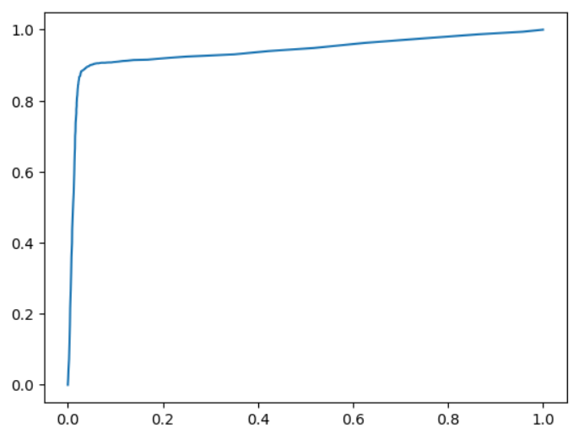
Graph of Best fitted model:
AUC & ROC

Slide 7
EDA
Visualization
Class Imbalance Treatment
Smote
Outliers
Skewness

Slide 8
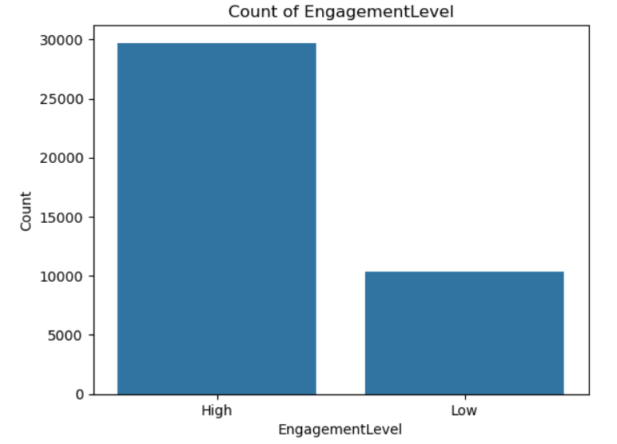
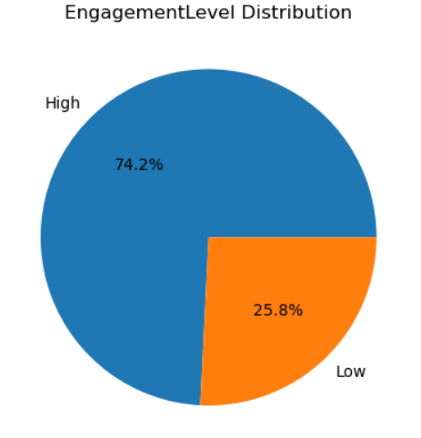
Visualization:
Engagement level Distribution and its count:

Slide 9
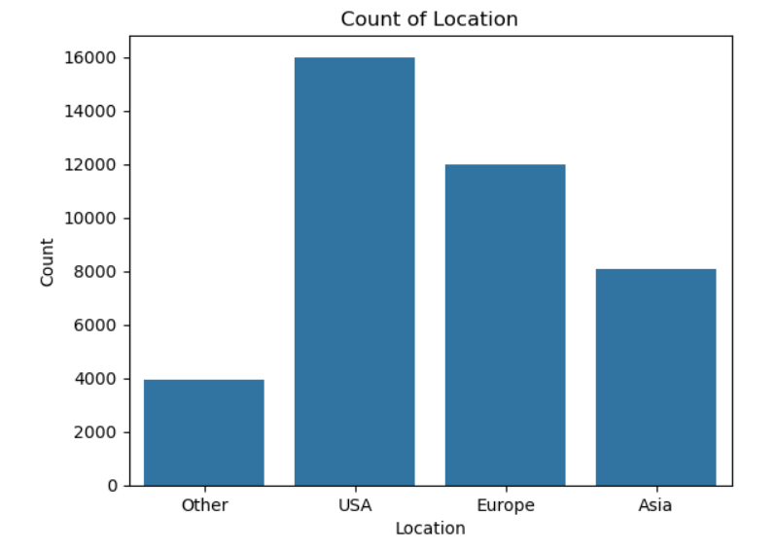
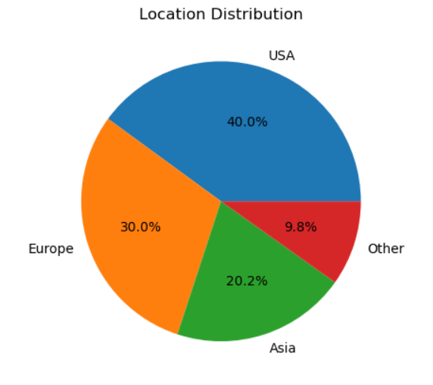
Location distribution and its count:

Slide 10
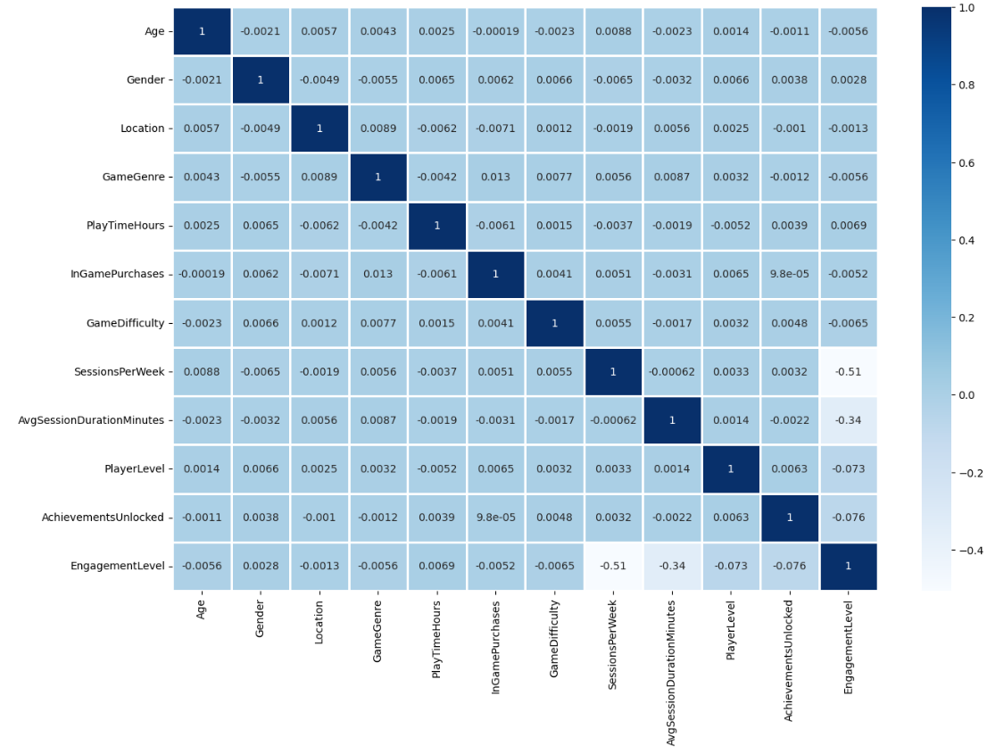
Heat Map

Slide 11
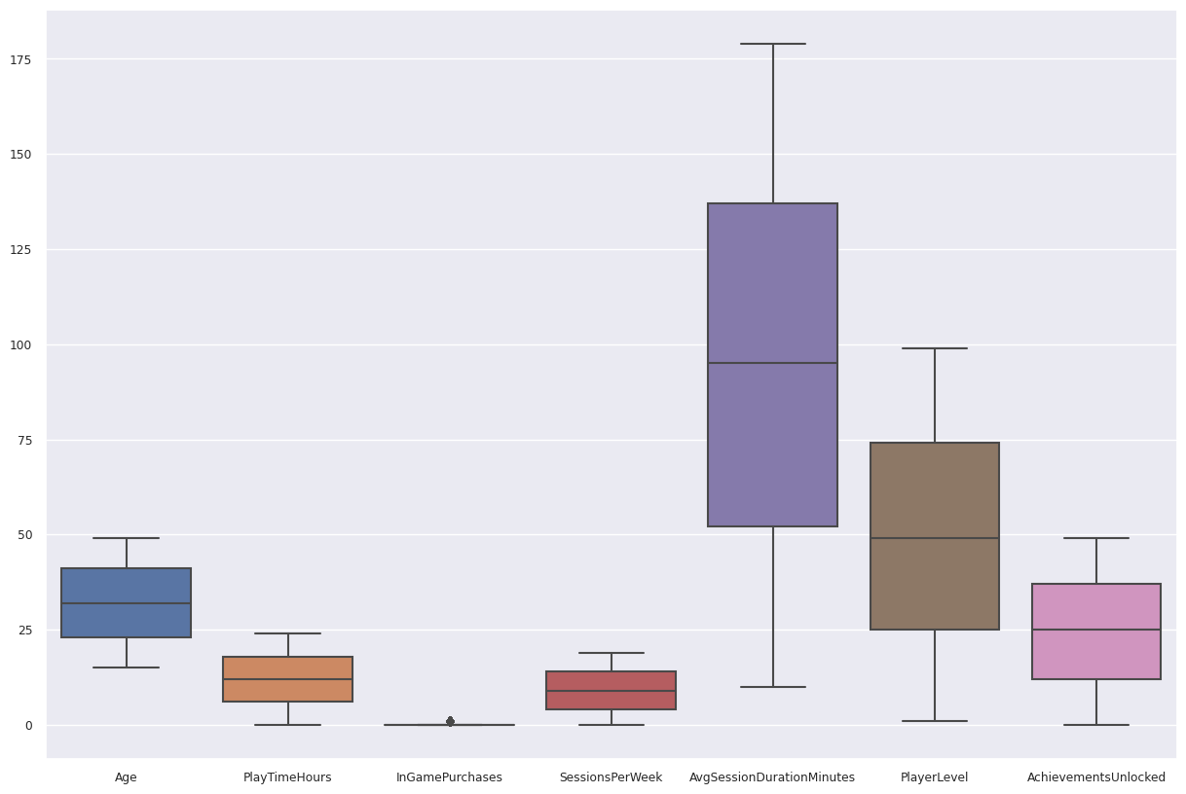
Outliers:

Slide 12
Outliers & Skewness:
Outliers:
No outlies detected in the Dataset
Skewness:
No skewness detected in the Dataset

Slide 13
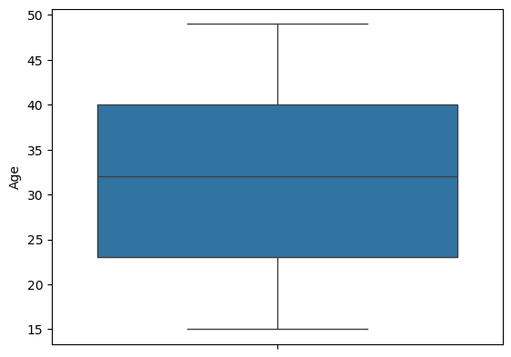
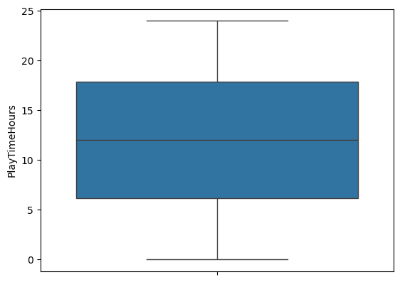
Box Plot of numerical column:

Slide 14
Class Imbalance Treatment:
The dataset we are working with has class imbalance issue in Engagement Level (Target):
High- 29710
Low-10324
So we are using SMOTE to treat the imbalance issue, and the results are good:
High-59420
Low-59420

Slide 15
Data Table(SMOTE):
Model name | Accuracy | Precision | Recall | F1 Score
logistic | 85.703467 | 0.861255 | 0.492849 | 0.626937
DT | 89.868731 | 0.904885 | 0.492762 | 0.638062
RF | 93.840458 | 0.955702 | 0.762194 | 0.848049
KNN | 86.805789 | 0.836741 | 0.859163 | 0.847804
SVM | 90.752272 | 0.923157 | 0.490374 | 0.847804
NB | 71.112420 | 0.703030 | 0.509376 | 0.590737
Conclusion: From the above models Random Forest is the best model

Slide 16
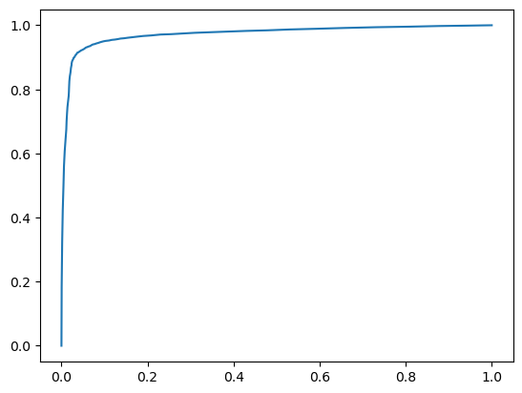
Graph of Best fitted model:
AUC & ROC

Slide 17
Feature Selection:
We have used Chi-Square technique in feature selection
From the data set unwanted features like Age, Gender, Location, Game Genre, Play Time Hours, In Game Purchases, Game Difficulty are removed
Then we took the best model which is Random forest and applied chi-square technique
Skewness:
No Skewness is detected

Slide 18
Data Table -3
Model name | Accuracy | Precision | Recall | F1 Score
Rf | 93.874116 | 0.955702 | 0.762194 | 0.848049
Feature selection | 94.219118 | 0.921305 | 0.961565 | 0.941005
Xgboost | 93.773140 | 0.921305 | 0.961565 | 0.941005
From the all above models Xgboost is performing good.

Slide 19
Cross Validation
Reduces overfitting by ensuring that the model is evaluated on multiple data splits.
Provides a better estimate of model performance on unseen data.
We used Stratified Kfold method where our accuracy is quite good.
Stratified CV accuracy: 0.90

Slide 20
Draw Backs:
Player addiction is also influenced by various external factors (e.g., social influence, game updates) that may not be captured in the dataset, limiting prediction accuracy.
The dataset might become outdated as player preferences and gaming environments evolve, requiring frequent updates and model retraining.
Applying the model to large-scale gaming environments might require significant computational resources and time

Slide 21
Thank You

